Slide 1
Day01 Advanced C#

Slide 2
Nullable Types
Allow value types to store null
Useful when a value might be missing
Check using HasValue or == null

Slide 3
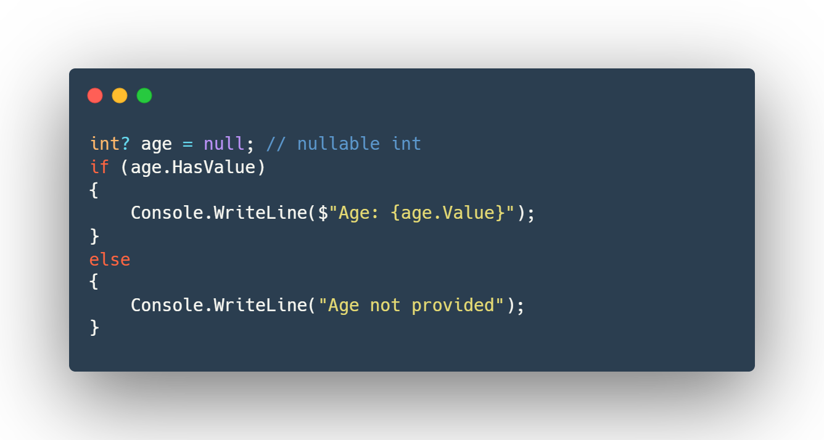

Slide 4
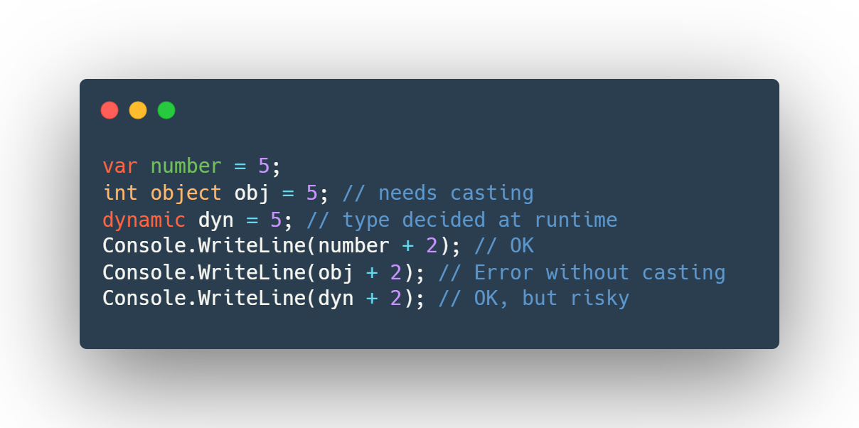
var vs dynamic vs object
var: Type inferred at compile time
dynamic: Type resolved at runtime
object: Base type for all types
var is safe, dynamic is flexible but risky
Example

Slide 5
params keyword
Allows passing a variable number of arguments
Placed as the last parameter in a method

Slide 6
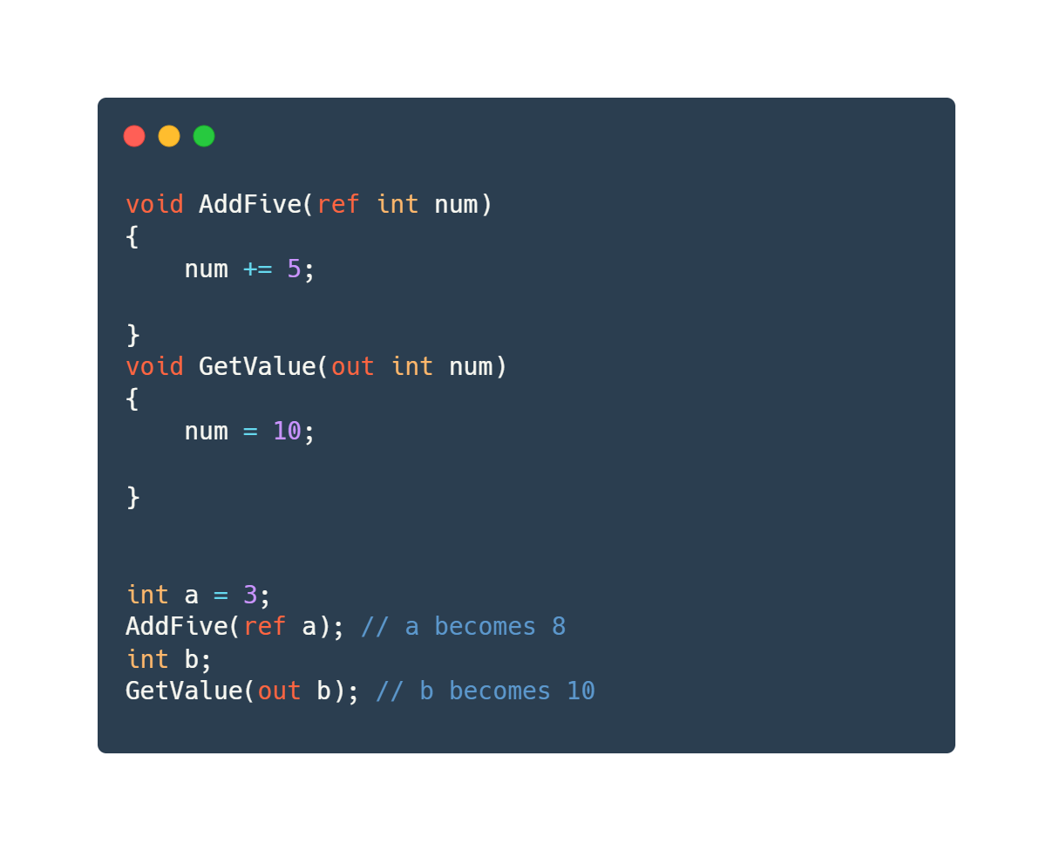
ref and out
ref: Pass by reference, must be initialized before passing
out: Pass by reference, must be assigned inside method
Example

Slide 7
Generics
Write code that works with any data type
Provides type safety and reusability
Examples: List<T>, Dictionary<TKey, TValue>

Slide 8
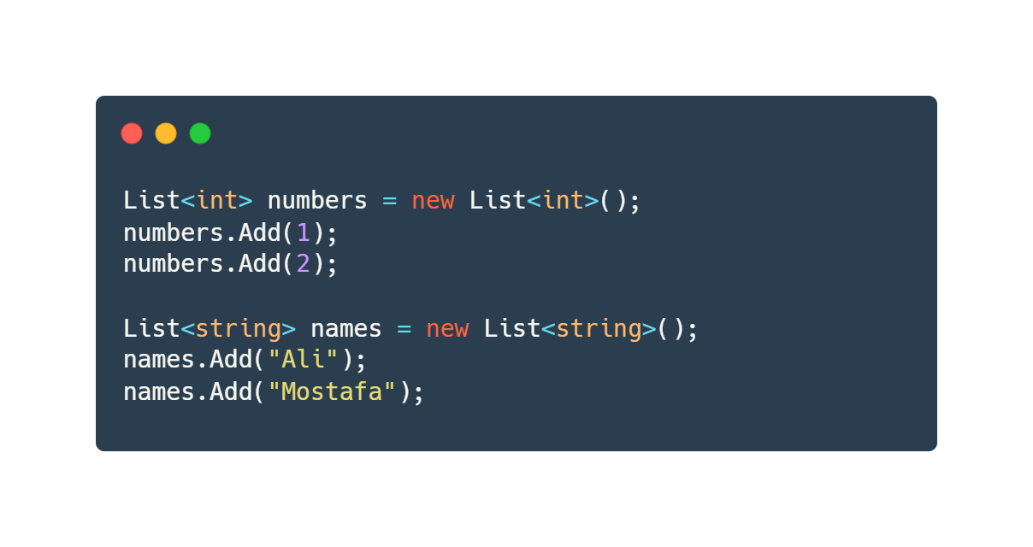

Slide 9
Anonymous Types

Slide 10
Create objects without defining a class
Properties are read-only
Often used with LINQ

Slide 11
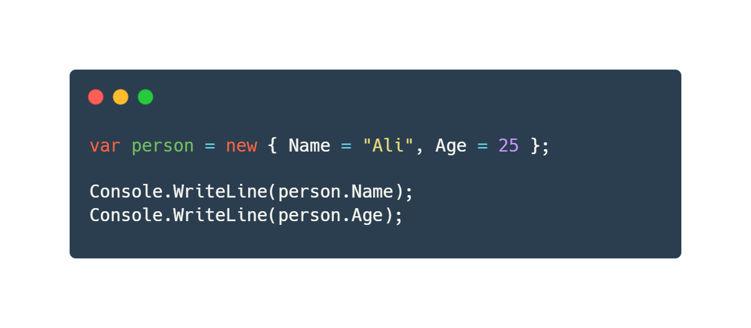

Slide 12
Lambda Expressions
Short syntax for anonymous methods
Often used in LINQ and event handling
Syntax: (parameters) => expression

Slide 13
Thank You

